Slide 1

DEEP LEARNING OPTIMIZERS
ADAPTIVE LEARNING ALGORITHM
GROUP 2 TEAM
Aman Kassahun Wassie Yaseen Eltahir Catherine Monoue Ifeoma Veronica Nwabufo

Slide 2
OUTLINE
INTRODUCTION
OPTIMIZERS
CODES: RESULTS
CONCLUSION

Slide 3
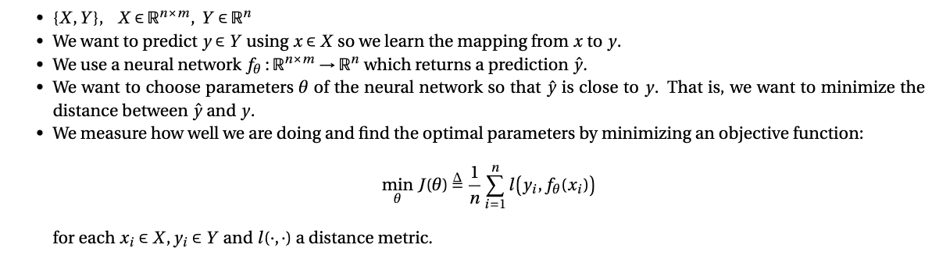
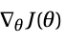
INTRODUCTION
Mathematical Formulation
Gradient Descent Algorithm
Repeat until convergence:
Compute the gradient of the objective function
Update the parameters

Slide 4
INTRODUCTION
First generation
Second generation: Adaptive learning
Batch (Vanilla) gradient descent
Stochastic gradient descent
Mini batch gradient descent
Momentum
Nesterov accelerated gradient
Adagrad
Adadelta
RMSprop
Adam

Slide 5
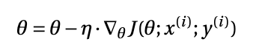
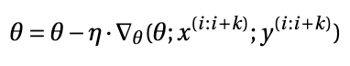
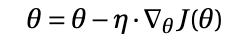
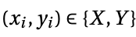
OPTIMIZERS: First Generation
Batch gradient descent (BGD)
Stochastic gradient descent (SGD)
Mini-batch gradient descent (MBGD)
Gradient updates after calculating loss of entire training example.
High resource demands - lots of space in memory.
Long training time.
Gradient updates after loss for one training example
Faster training time than BGD.
Less need for memory.
Gives quick info about model performance.
Suitable for online learning.
Gradient updates per batch.
Less noisy than SGD.
Fewer steps to converge than SGD.
Takes fewer steps to converge.
Perfect gradient.
Noisy gradient.
Many steps to converge.
Optimal batch size may be difficult to get.

Slide 6
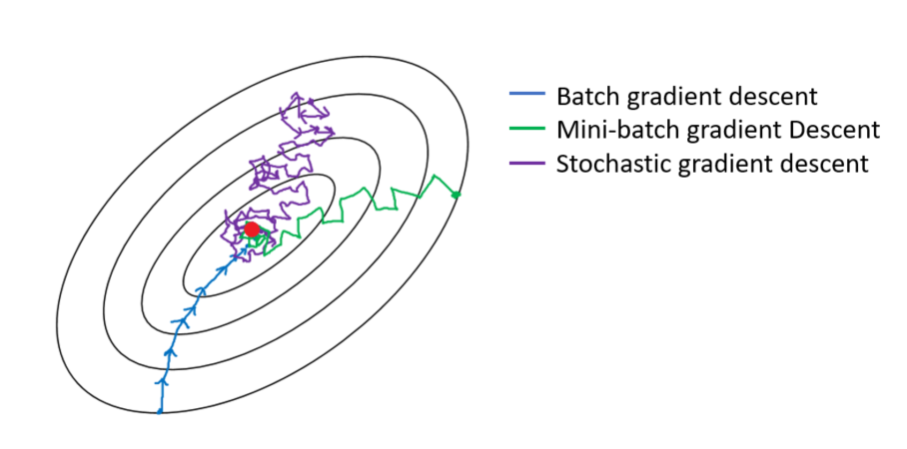
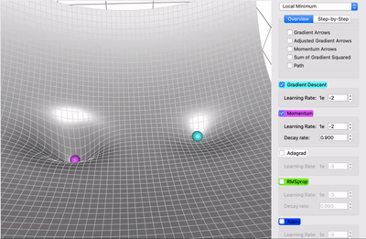
OPTIMIZERS: First Generation
Convergence steps
Challenges
Local minima
Figure 2: Momentum (magenta) vs. Gradient Descent (cyan) on a surface with a global minimum (the left well) and local minimum (the right well
Figure 1: Convergence diagram for BGD, SGD, MBGD
Plateau, Saddle point
How to adjust the learning rate
Choice of a proper learning rate
Figure 1 Source
Figure 2 Source
Dealing with sparse data

Slide 7
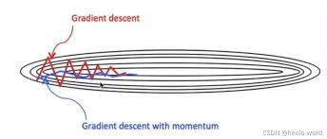
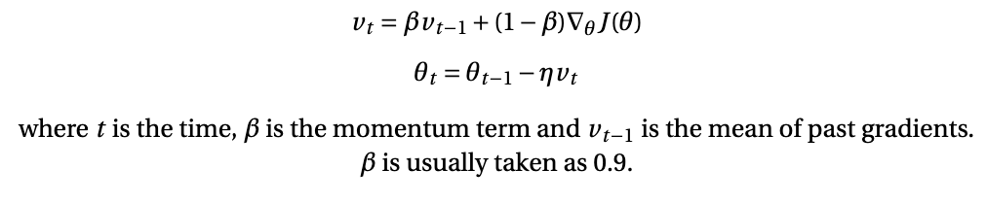
MOMENTUM
Our goals:
We do not want the high oscillations.
We want to move towards the minimum faster.
Smoothens the noise.
Gives weight based on the previous steps.
Figure 3: Gradient Descent with Momentum
Figure 3 Source

Slide 8

OPTIMIZERS: Second Generation
With the momentum, we try to increase the convergence speed and avoid local minima
?
What about sparsity in data
+
Keep updating the parameters as there is no difference between their associated features?
Why?
The average gradient for sparse feature is small, so slower rate of training.
Can end up with saddle point.

Slide 9
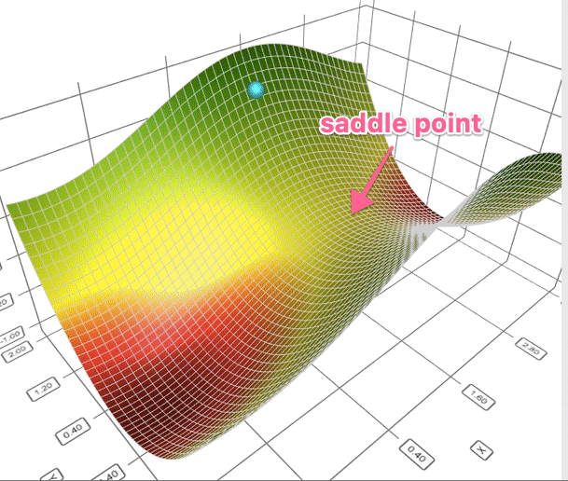
OPTIMIZERS: Second Generation
Adaptive learning algorithms avoid saddle points.
Definition
Adaptive learning algorithm is an algorithm which tries to adjust the learning rate to the specificities (frequency) of features associated to a parameter and the stage of the optimizing.
Figure 4: Illustration of saddle point
Figure 4 Source

Slide 10
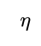
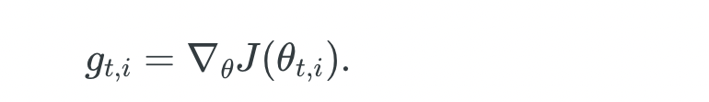
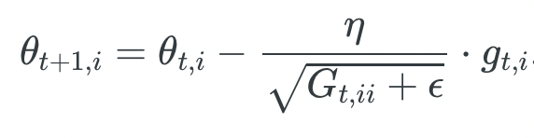
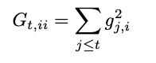
OPTIMIZERS: Second Generation
Choose the learning rate
Adagrad
where
Individualise learning rate
Mesures how much we have moved
Advantage:
Deals with sparse features.
Limits:
Slow convergence because the learning rate is drastically reduced.
End up with infinitesimally small learning rate which leads to no learning.

Slide 11
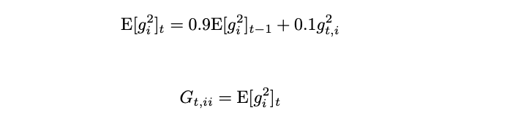
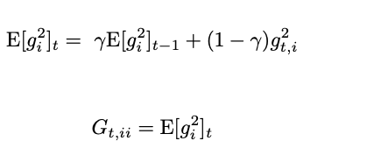
OPTIMIZERS: Second Generation
Choose the learning rate
RMSprop
Exponential moving average
where
Advantage:
Faster than Adagrad.

Slide 12
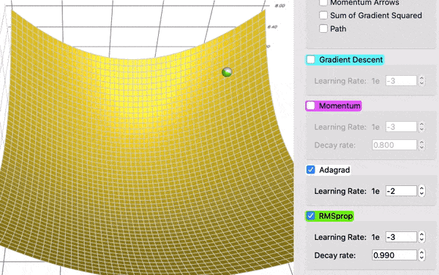
OPTIMIZERS: Second Generation
Figure 5: Illustration of the improvement of Adagrad with RMSprop.
Figure 5 Source

Slide 13
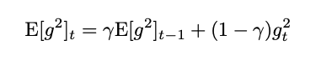
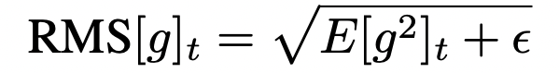
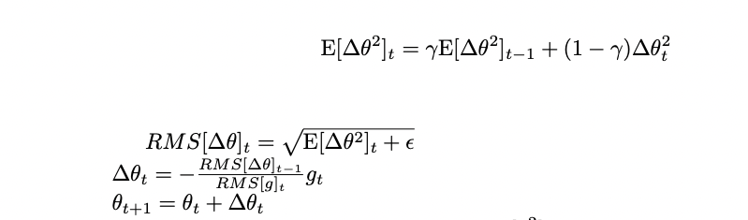
OPTIMIZERS: Second Generation
Adadelta tries to:
improve Adagrad as RMSprop
solve some problems with unit
and
Replace the previous learning rate to solve unit issue
Adadelta
and
Advantages:
No need to choose a global learning rate
robust to large sudden gradient

Slide 14
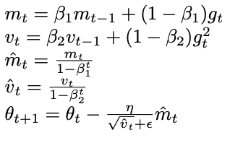
OPTIMIZERS: Second Generation
Adam wants to:
Adapt learning to each feature.
Reduces the noise in the gradient (momentum).
Choose the learning rate
Advantages:
Succeeds in avoiding local minima.
Can escape plateau region.
Adam

Slide 15
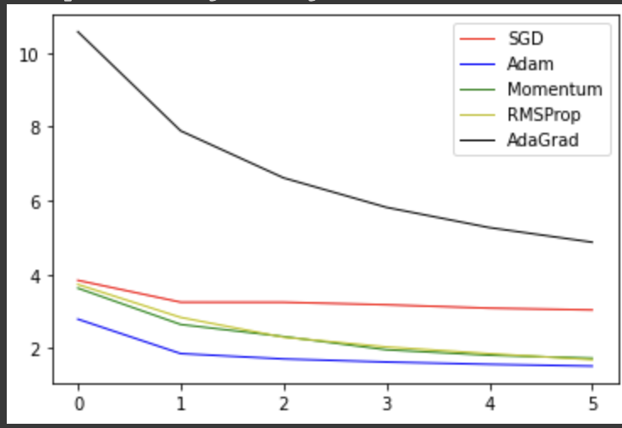
CODES: Results
We implement a neural network on MNIST dataset and check the performance of different optimizers.
Figure 6: Convergence behaviours of different optimizers on a neural network.

Slide 16
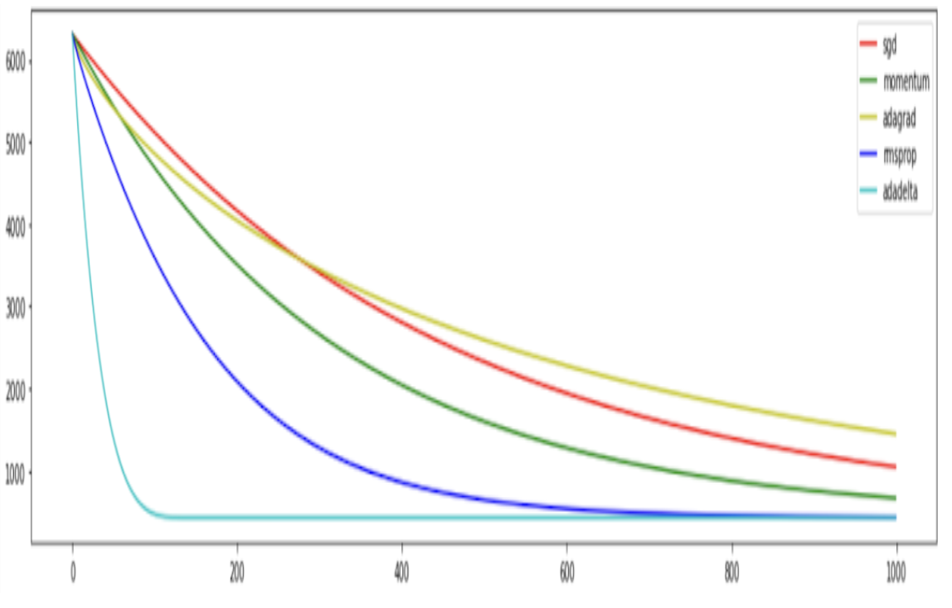
CODES: Results
Dataset
We implement linear regression on randomly generated data using Sklearn datasets.
Figure 7: Convergence behaviours of different optimizers using linear regression.

Slide 17
CONCLUSION
The optimization step is an important part of the machine learning program as observed by all the propositions made by research.
We can divide the optimizers based on gradient descent in two generations: First generation which uses the same learning rate throughout the network while the second generation adjusts the learning rate based on the layers.
We saw that the optimizers try to improve speed in convergence, solve the issues associated with choosing the appropriate learning rate and its scheduling, escape regions of local minima, plateau, and/or saddle points.
Based on the literatures, only the Adam optimizer is able to give the solve all those problems.

Slide 18
BIBLIOGRAPHY
Diederik P. Kingma, Jimmy Ba: “Adam: A Method for Stochastic Optimization”. ICLR (Poster) 2015
Matthew D. Zeiler. “Adadelta: An Adaptive Learning Rate”, 2012
Ashok Cutkosky, Harsh Mehta. “Momentum Improves Normalized SGD”, 2020.
Ruoyn Sun. “Optimization for deep learning: theory and algorithms”, 2019
Sebastian Ruder. “An overview of gradient descent optimization algorithms” Accessed 27 April 2022, <https://ruder.io/optimizing-gradient-descent/>
“Deep Learning - All Optimizers in One Video.” YouTube, premiered by Krish Naik, 03 Nov 2020, https://www.youtube.com/watch?v=TudQZtgpoHk

Slide 19
Thank you for your kind attention

